Slide 1


PLEDGE TO PROGRESS Sustainability Hackathon
Sponsored By
Your Team Name : Access Denied
Your team bio : A sustainable and incentivising approach for waste management.
Date : 24/04/2023

Slide 2
Problem Statement?
The current waste management practices are not only inefficient but also unsustainable, leading to significant environmental degradation and posing a threat to public health and safety. I.e. Scattered waste management ecosystem lacks focus on incentivizing users and contributors to participate in sustainable waste management practices.
Why did you decide to solve this Problem statement? The problem of inefficient and unsustainable waste management practices with inadequate CSR implementation and user base expansion for MNCs and influencer companies exists.
To address this problem, we propose to establish an ecosystem for waste management with no middlemen.
Our solution aims to incentivize MNCs and influencer companies to adopt sustainable practices, improve their CSR, and expand their user base using incentivizing tokens.
By eliminating middlemen, we seek to promote a more environmentally conscious and socially responsible waste management system.
Our solution provides opportunities for businesses to expand their user base and improve their corporate social responsibility.

Slide 3
User Segment & Pain Points
Which user /advertiser segment would be early adopter of your product & why?
The early adopters of our waste management ecosystem with incentivizing tokens are likely to be large multinational corporations (MNCs), influencer companies, and environmentally conscious consumers.
MNCs are adopting sustainable practices, and our solution provides an opportunity for them to effectively implement such practices while expanding their user base.
Influencer companies are always looking for innovative ways to expand their user base, and our incentivizing tokens can help them achieve this while promoting sustainable waste management practices.
Environmentally conscious consumers are likely to be early adopters of our solution as it aligns with their values and provides incentives to contribute to a more sustainable future.
Companies that prioritize social responsibility, value user engagement, and prioritize innovation as it provides a means to engage with users, promote social responsibility, and incorporate community feedback into future platform releases
Our solution offers a unique and innovative approach to waste management, promoting sustainability while providing incentives to users and contributors, making it an attractive proposition for businesses and consumers.

Slide 4
Prerequisite
What are the alternatives/competitive products for the problem you are solving? 1. thekabadiwala.com 2. pastiwala.in
How we differ with their ideology is we ask the companies itself to handle waste management as the creators of any product have the best way to handle and recycle it, and also to refurbish it and resell it and they may provide the best value for their scrap. We give them the power to recycle the scrap themselves at their own inventories and reward token to the users who bring it to them. These users can redeem their tokens at any of the influencer companies while purchasing products or doing any transactions.

Slide 5
Tools or resources
Azure tools or resources which are likely to be used by you for the prototype, if your idea gets selected Azure Cognitive Services: This is a collection of pre-built APIs that enable you to add intelligent features to your applications, such as image recognition.
Azure Web Apps: This is a platform as a service (PaaS) offering that allows you to deploy and scale web applications in the cloud. With Azure Web Apps, you can build a user-friendly web interface for your waste management application, and easily manage its deployment and scalability.

Slide 6
Any Supporting Functional Documents
Supporting Documents: - Research Paper - 1
Architecture/Methodology:
Some Azure Services for various edge cases.
Website: to advertise and actively engage with the community, dashboard interface
Mobile App: for the users to track their progress and engage with the community, also to integrate their tokens with their UPI accounts and redeem their tokens whenever they want
Smart contracts: to make Web3 transactions (tokens exchange) easier
Node.js Backend: to support social media and advertisements (beta: migrate functionalities to Smart Contracts)
Scalability
Auto scaling for services using Azure
Setting up custom DevOps pipelines for each build and following a container based microservices approach.

Slide 7
Key Differentiators & Adoption Plan
How is your solution better than alternatives and how do you plan to build adoption? Our solution stands out by allowing companies to handle waste management themselves, recycling their products in the most effective way possible.
We incentivize users to bring their waste to these companies through a token reward system and promote social responsibility and community engagement.
Our influencer companies' user base will be leveraged to promote our solution, highlighting the benefits of our approach.
Any company can get involved with our platform as an Influencer company, wherein they will have to provide the users some threshold values to get their tokens redeemed.
Collaboration with local municipalities will also be pursued to promote our solution and increase adoption.

Slide 8
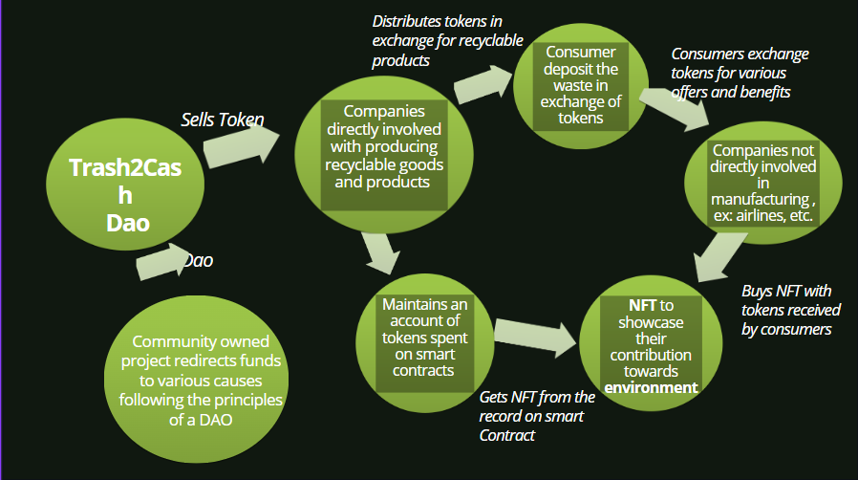
GitHub Repository Link & supporting diagrams, screenshots, if any
The flowchart of how the application will work
Our DAO

Slide 9
Thank You
Ashutosh Jha (ashutoshj887@gmail.com)
Sayantani Deb (debsayantani99@gmail.com)

